Slide 1
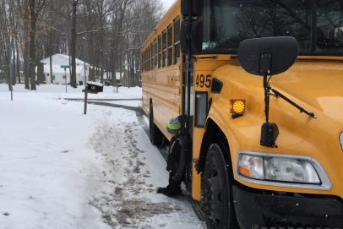
School Bus Service Door Draggings – Grassroots Prevention
Bob Peters, CDPT Kathleen Furneaux CDPT-SNT Peter Lawrence, Ed.D., CDPT
NC Dept of Public Instruction Pupil Transportation Safety Institute Fairport CSD
Raleigh, North Carolina East Syracuse, New York Fairport , New York
919-807-3570 800-836-2210 585-721-0899

Slide 2
Draggings – A National Problem
NBC News - Kentucky School Bus Dragging
Notes:
Click to open the link to a video from NBC news about the Kentucky School Bus dragging
http://www.nbcnews.com/watch/nbc-news-channel/camera-captures-girl-dragged-by-school-bus-446597699687

Slide 3
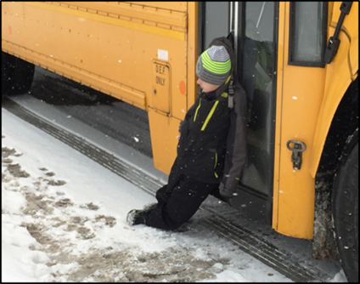
Draggings – Let’s Start A National Dialogue!
Have you discussed the issue of school bus draggings with your Drivers?
What did these discussions entail?
What have you learned about draggings?
What do you think causes these draggings?
How can we prevent them?

Slide 4
What the Data Shows Us…
Notes:
Between 2004-15 - 30 students have been dragged by their school buses in 17 States. But there have probably been more…

Slide 5
Dragging Distances…
From less than 20'
More than to 17x’s length of a football field…
Notes:
< 20’ to 5,200’
More than 17 football fields long…

Slide 6
Types of Draggings

Slide 7
More Data…

Slide 8
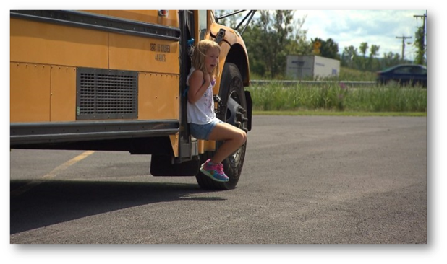
National Attention – Inside Edition
Contacted us to help get the word out…
Peter and I worked with them closely
Hours and hours of footage – good material
Unfortunately, very little of the prevention information made the final cut…
Let’s watch the video footage that aired on September 8th…

Slide 9
Inside edition
Notes:
Click on link to view Inside Edition report on school bus dragging.
http://www.insideedition.com/videos/5492-watch-7-year-old-girl-get-dragged-by-bus-after-backpack-gets-stuck-in-door

Slide 10
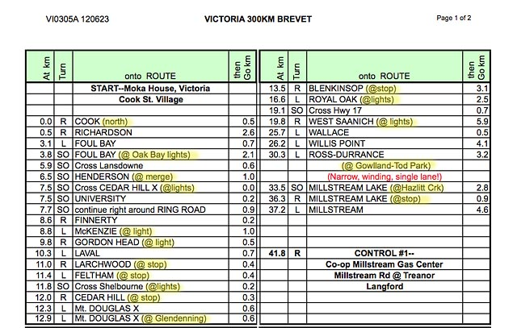
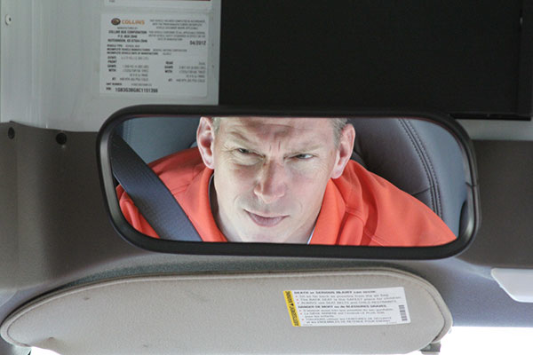
Contributing Factors…
In a busy world there are as many distraction for drivers as there are vehicles on the road…
You tell his Mom and Dad you only looked down for a second…
Notes:
What’s wrong with this picture? (Driver’s hands, how about the Kindle?)
Ask the audience what distractions they face on the roads.
-Two-way radio
-Student behavior
-Traffic congestion
-Distracted drivers
-Other motorists errors
-Bus stop challenges
-Pedestrians and bicyclists
-Route hypnosis, etc.

Slide 11
Distraction & Focus
Focusing on many things all at once:
Unloading instructions
Counting children
Communicating with parents
Watching mirrors
Tracking traffic flow and stop arm compliance
Student management
Notes:
Kathy we can add more details and examples

Slide 12
Distraction & Focus
Notes:
I want you to watch this short video and count the number of passes made by the students in white tee shirts. If you have seen this video, please remain silent for this video and do not share the answer. After the video, we will report out the actual number of passes completed.
Show Invisible Gorilla Video Clip then discuss how people stich memories and thoughts together.
-Authors’ Chabris and Simons had two studies by SurveyUSA:
1) Conducted a national survey of 1,500 adults in the U.S. in June of 2009 and it indicated that more than 75% of the respondents agreed that they would notice such unexpected events, even when they were focused on something else (p. 7).
2) 63% of Americans consider themselves more intelligent than the average American while 70% of Canadians consider themselves more intelligent than the average Canadian.

Slide 13
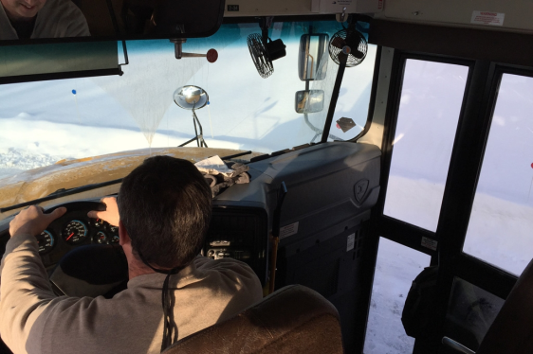
Looking But Not Seeing…
Inattentional Blindness
Over confidence of abilities
Looked but failed to see
Notes:
Inattentional Blindness: An error that occurs results from a lack of attention to an unexpected object (p. 6).
Over confidence of abilities: SurveyUSA conducted a national survey of 1,500 adults in the U.S. in June of 2009 and it indicated that more than 75% of the respondents agreed that they would notice such unexpected events, even when they were focused on something else (p. 7).
Looked but failed to see: “We think we should see anything in front of us, but in fact we are aware of only a small portion of our visual world at any moment” (p. 13).
Commander Waddle of the USS Greenville who performed an “emergency deep” maneuver right into a 200’ long fishing boat at 1:40 p.m. on February 9, 2001. “The lies in what he thought he would see when he looked: As he said later, ‘I wasn’t looking for it

Slide 14
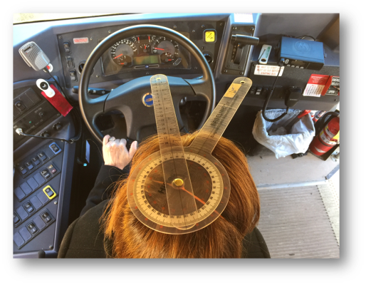
Contributing Factors…
Switch locations
Peripheral vision
Head position
Notes:
Ask the audience where are your service door switches located on your buses? Poll by show of hands. How many have buses where the door control is on the steering wheel? What challenges can that pose for a substitute driver if your fleet of vehicles is mixed?
Ask the audience what is the maximum number of degrees humans are capable of seeing. Then share that the Federal physical allows drivers to have a minimum of 70 degrees in each eye or 140 degrees. NOTE: Difference in seat pedestal height compared to the lowest step tread height.
Explain how service door switches located on the left of the steering wheel force the driver to turn their head approximately 45 degrees away from the service door.

Slide 15
Move the Air Door Switch to the Right…
Notes:
When the door switch is moved to the right of the steering wheel the driver’s peripheral vision is shifted ~38 degrees or more toward the service door as opposed to 45 degrees away from the service door.
Relocating the switches are one option and specifying the service door switch on the right of the steering wheel is another option.

Slide 16
Mirror Adjustment is Critical!
Notes:
See ROSCO for a free video on mirror adjusting grids or contact your bus manufacturer for instructions.
Bonus question on mirror adjustment: When setting up your buses to fit your drivers, what height driver should you use for your fleet?

Slide 17
Tragedy Prevention Strategies
Five Seconds…
Scan all mirrors
Check the door for passengers
Check cross-over mirrors
“Check the door – once more!”
Perform mirror sweep again
Notes:
Free downloads for posters at PTSI website.

Slide 18
Just Before Moving the Bus…
Start a campaign! Make it the Driver’s Mantra!

Slide 20
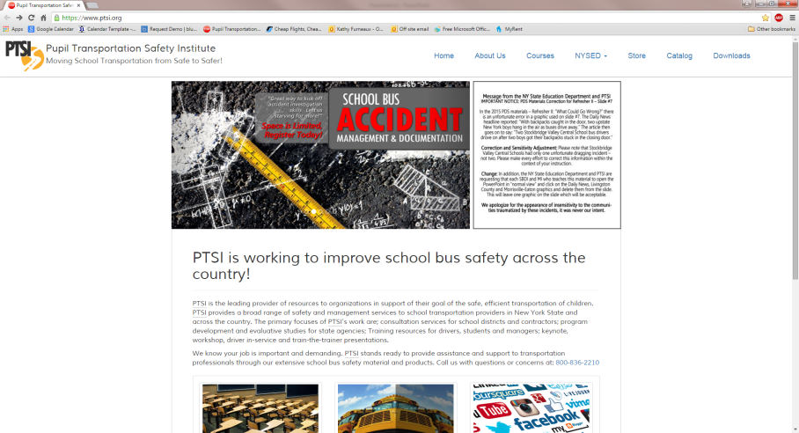
Free Materials!
PTSI’s website: www.ptsi.org

Slide 21
Print Into Posters and Handouts!

Slide 22
Let’s Start A National Dialogue and Mantra Campaign Together!
Kathleen Furneaux
kathy@ptsi.org
(800) 836-2210
Peter Lawrence
plawrence@fairport.org
(585) 421-2025

